Slide 1
UI/UX

Slide 2


What is UX ?
UX stands for User Experience
You can use any device or any product or even use anything.
If you feel comfortable using them, consider it’s UX is better.
Experience is something you can feel and you get when using something- that’s your experience And if that’s bad, then bad User experience
Example:

Slide 3

User Expericence Research

Slide 4


Slide 5
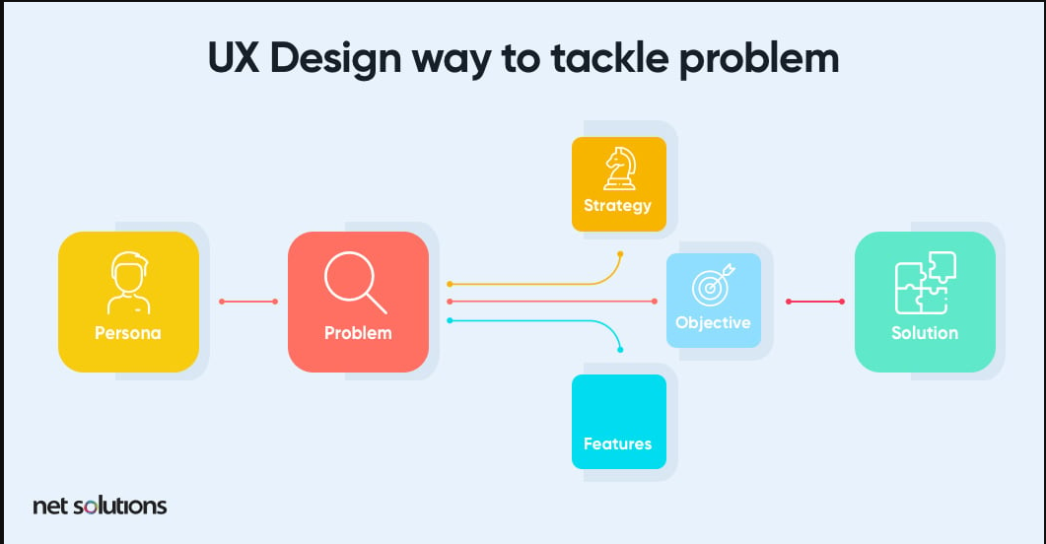

Slide 6
